Slide 1
Financial Modeling
Bond and Stock Valuation
Jacqueline Garner, Ph.D.
Lecturer
Scheller College of Business
Non-constant Dividend Growth Model
Notes:
Hello, I’m Jacqueline Garner, and welcome to Financial Modeling

Slide 2
Before We Begin…

Slide 3
Non-Constant Dividend Growth Model, “NCDG”
The non-constant dividend growth model assumes
The stock pays dividends
The growth rate in dividends is not constant, but becomes constant at some future point
Required return of investors is greater than the constant growth rate

Slide 4
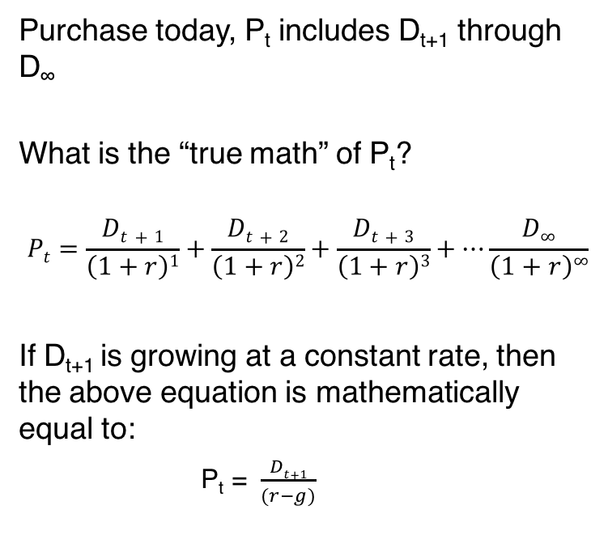
Dividend Paying Stock
Purchase today, P_{t} includes D_{t+1} through D∞
What is the “true math” of P_{t}?
$$Pt=\frac{Dt+1}{\left(1+r\right)1}+\frac{Dt+2}{\left(1+r\right)2}+\frac{Dt+3}{\left(1+r\right)3}+…\frac{D∞}{\left(1+r\right)∞}$$
If D_{t+1} is growing at a constant rate, then the above equation is mathematically equal to:
P_{t} = $\frac{Dt+1}{(r−g)}$
Notes:
This is all still true, but now, the first dividend may not be behaving, therefore, you need to find which dividend will work in the “collapsed math”

Slide 5
Non-constant Dividend Stock Model
Let’s work some examples in the file:
Stock_Valuation_Examples

Slide 6
Summary

